Slide 1
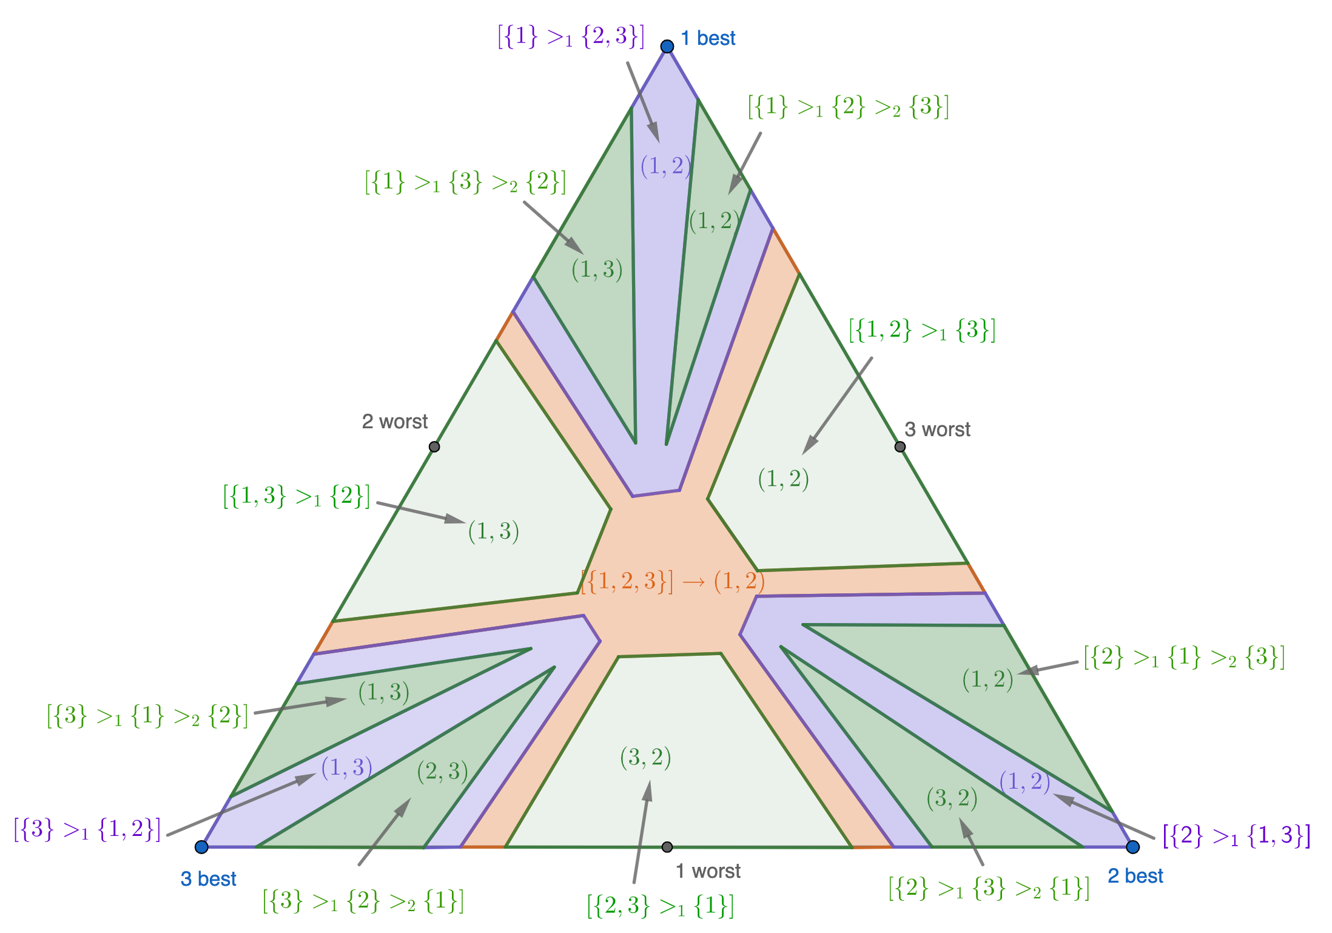
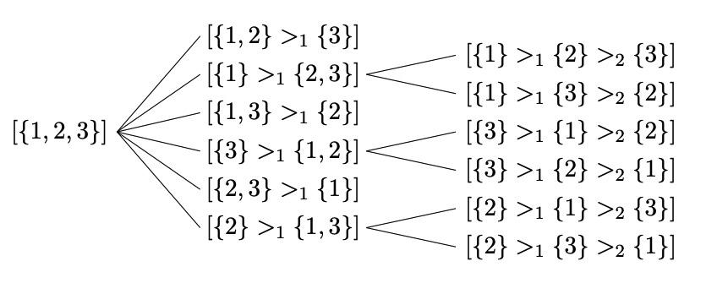

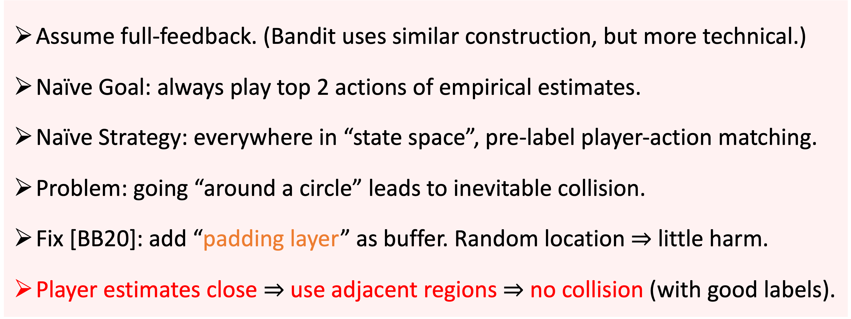
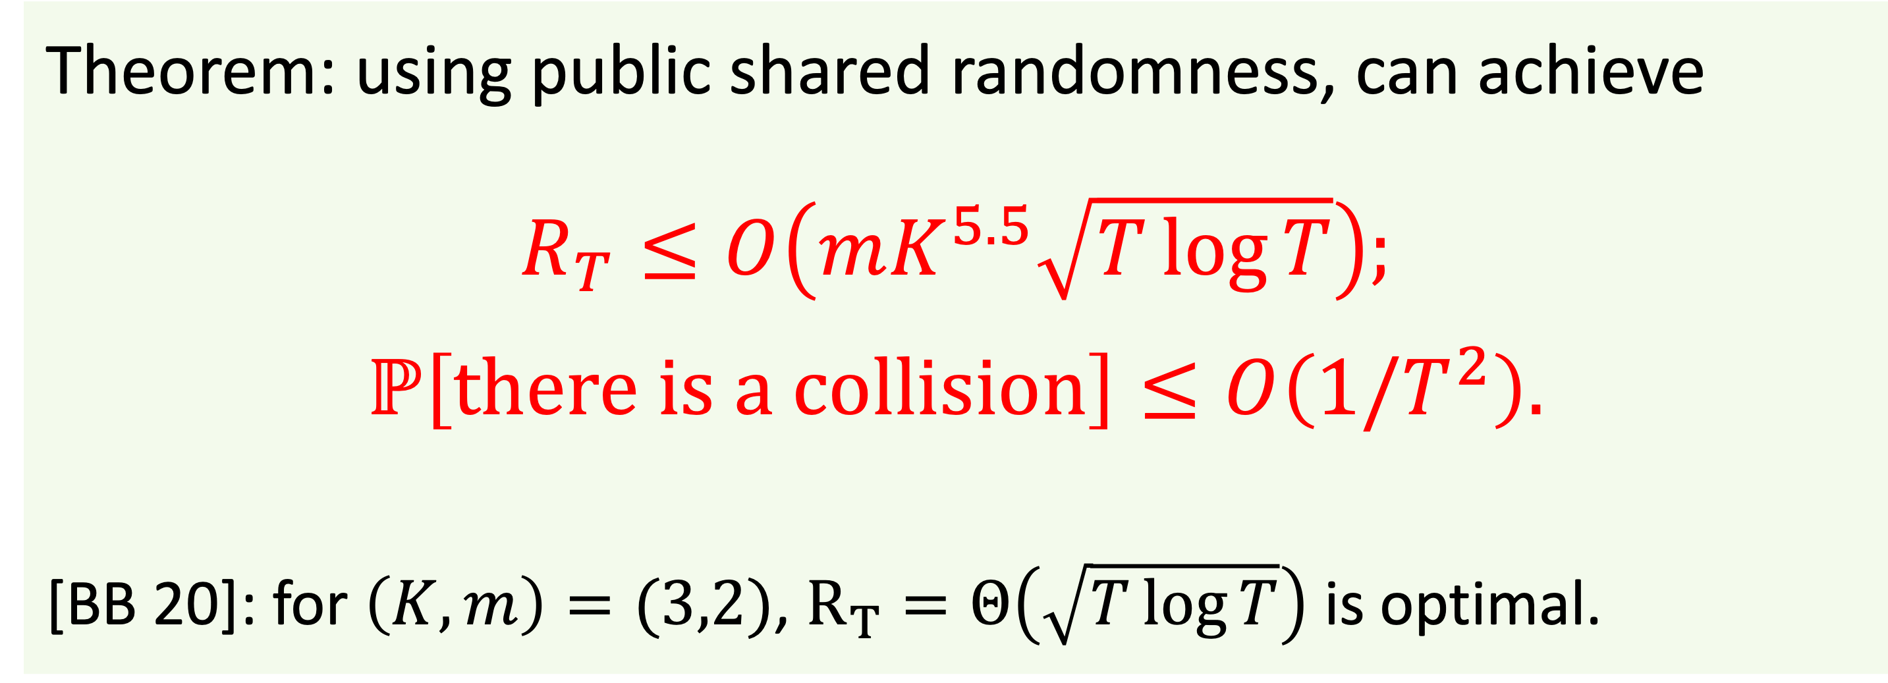

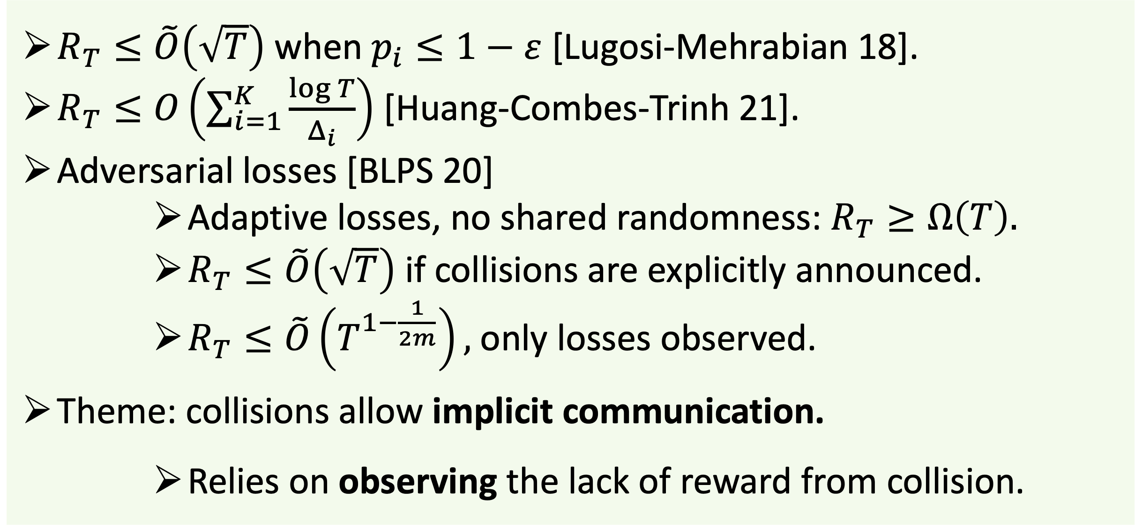
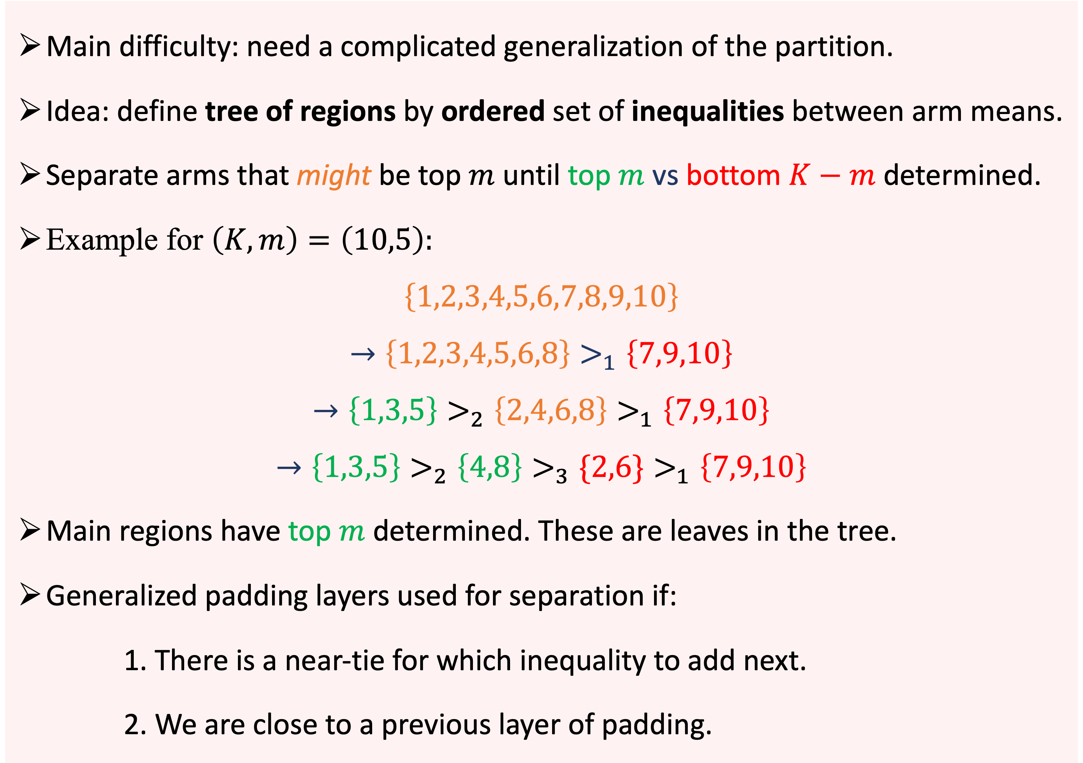
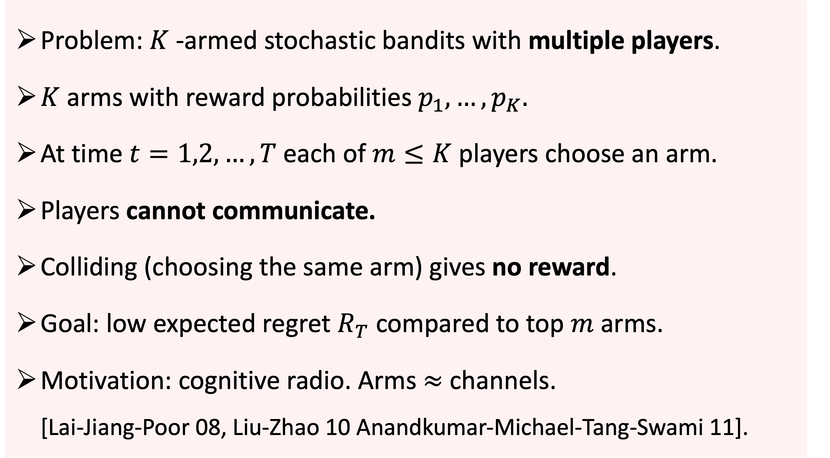
Cooperative and Stochastic Multi-Player Multi-Armed Bandit:
Optimal Regret With Neither Communication Nor Collisions
Sébastien Bubeck (Microsoft), Thomas Budzinski (ENS Lyon), Mark Sellke (Stanford): COLT 2021
The Setup
1
Main Result: Optimal Regret with No Collisions At All
New Ingredient: A Partition for General $\left(K,m\right)$
3
5
Problem: $K$-armed stochastic bandits with multiple players.
$K$ arms with reward probabilities $p_{1},…,p_{K}.$
At time $t=1,2,…,T$ each of $m≤K$ players choose an arm.
Players cannot communicate.
Colliding (choosing the same arm) gives no reward.
Goal: low expected regret $R_{T}$ compared to top $m$ arms.
Motivation: cognitive radio. Arms $≈$ channels. [Lai-Jiang-Poor 08, Liu-Zhao 10 Anandkumar-Michael-Tang-Swami 11].
Theorem: using public shared randomness, can achieve
$$R_{T}≤O\left(mK^{5.5}\sqrt{T\log{T}}\right);$$
$$ℙ\left[there is a collision\right]≤O\left(1/T^{2}\right).$$
[BB 20]: for $\left(K,m\right)=(3,2)$, $R_{T}=Θ\left(\sqrt{T\log{T}}\right)$ is optimal.
Main difficulty: need a complicated generalization of the partition.
Idea: define tree of regions by ordered set of inequalities between arm means.
Separate arms that might be top $m$ until top $m$ vs bottom $K−m$ determined.
Example for $\left(K,m\right)=\left(10,5\right):$
$$\left\{1,2,3,4,5,6,7,8,9,10\right\}$$
$$→\left\{1,2,3,4,5,6,8\right\}>_{1}\left\{7,9,10\right\}$$
$$→\left\{1,3,5\right\}>_{2}\left\{2,4,6,8\right\}>_{1}\left\{7,9,10\right\}$$
$$→\left\{1,3,5\right\}>_{2}\left\{4,8\right\}>_{3}\{2,6\}>_{1}\left\{7,9,10\right\}$$
Main regions have top $m$ determined. These are leaves in the tree.
Generalized padding layers used for separation if:
1. There is a near-tie for which inequality to add next.
2. We are close to a previous layer of padding.
Start from the root with no inequalities
Topological Obstruction and Padding Layer for $\left(K,m\right)=(3,2)$
4
Assume full-feedback. (Bandit uses similar construction, but more technical.)
Naïve Goal: always play top 2 actions of empirical estimates.
Naïve Strategy: everywhere in “state space”, pre-label player-action matching.
Problem: going “around a circle” leads to inevitable collision.
Fix [BB20]: add “padding layer” as buffer. Random location $⇒$ little harm.
Player estimates close $⇒$ use adjacent regions $⇒$ no collision (with good labels).
Some Existing Work
2
$R_{T}≤\tilde{O}\left(\sqrt{T}\right)$ when $p_{i}≤1−ε$ [Lugosi-Mehrabian 18].
$R_{T}≤O\left(\sum_{i=1}^{K}{\frac{\log{T}}{Δ_{i}}}\right)$ [Huang-Combes-Trinh 21].
Adversarial losses [BLPS 20]
Adaptive losses, no shared randomness:$R_{T}≥Ω\left(T\right).$
$R_{T}≤\tilde{O}\left(\sqrt{T}\right)$ if collisions are explicitly announced.
$R_{T}≤\tilde{O}\left(T^{1−\frac{1}{2m}}\right),$ only losses observed.
Theme: collisions allow implicit communication.
Relies on observing the lack of reward from collision.
Main region with top 2 determined
The combinatorial tree structure of regions
Main region with top 2 determined
Padding layer prevents collisions [BB20]
Level 2 Padding
Level 1 Padding (= Root)

